Slide 1


Slide 2


Slide 3

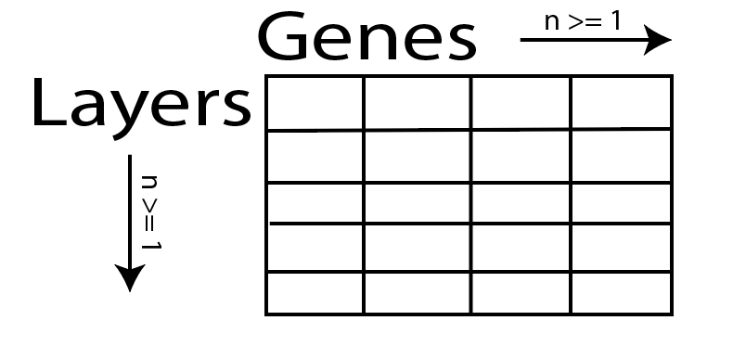

Slide 4
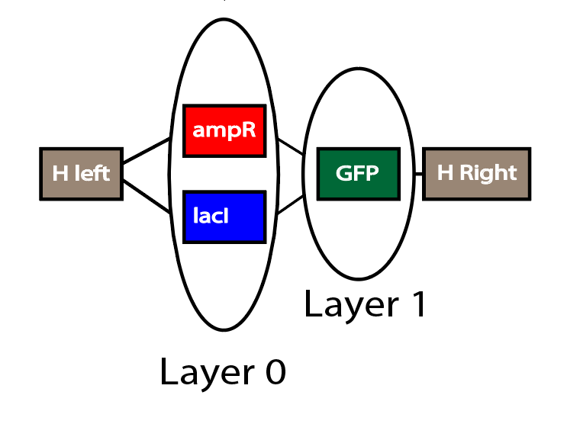
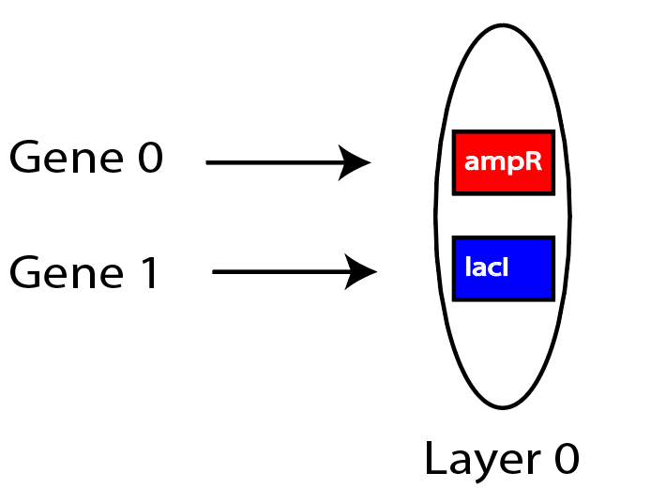

Slide 5
We will need these indices to insert in the GUI

Slide 7
1
3
2
4

